Slide 1
Not So Shiny Things that I learned about shiny, the “hard way”
October 2019

Slide 2
Adi Sarid
Professional: Market Research, Data Scientist, Operations Research, Educator
Academia: Mathematics, Statistics and Operations Research (Bsc, MA, Phd-in-process)
Software: R, Python

Slide 3

What inspired this talk? A Nasty Situation
A few years ago, I promised a client I will build something (sort of a small CRM)
It took me much more time, effort, and a few production emergencies
I decided to learn from this experience (and other experiences), and share some know-how

Slide 4
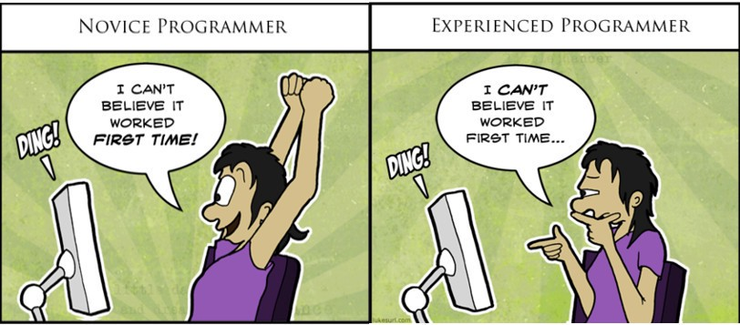
What’s not so shiny? depends…
Newbie
Intermediate
Advanced
Just starting to play with shiny
This is so cool, you can actually build stuff
You rock! Shiny rocks!

Slide 5
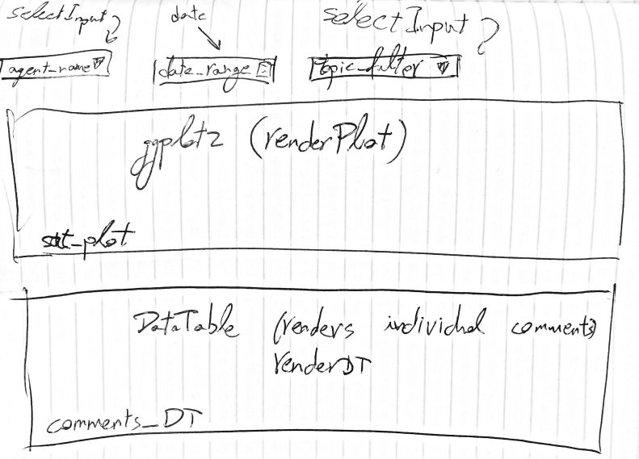
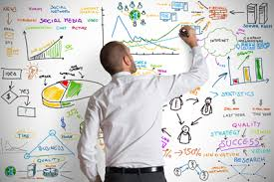

Newbie, Not So Shiny #1: Don’t rush into doing stuff
Invest in proper planning while you work, e.g.:
Build/draw a mockup.
Research.
Usually there is more than one solution to your challenge
Example 1: DataTable vs. handsontable
Example 2: base r vs. ggplot2 vs. plotly vs. r2d3 vs. …?
Read a lot.
mastering-shiny.org
stackoverflow
code/research widgets/app.R

Slide 6
Newbie, Not So Shiny #2: Not (truly) understanding reactivity
As a newbie, I just looked at a lot of examples and tried to copy the techniques in the examples.
However, doing so, I lacked an in-depth understanding of what is reactivity and how to leverage it.
For example, can you answer what is the difference between:
reactive
reactiveVal
reactiveValues
eventReactive
observe
observeEvent
Notes:
reactive() creates a reactive function (with dependencies). Usually this would be an “in-between” the inputs and outputs. Should be created once in the code and not touched further up.
reactiveVal() and reactiveValues() create a function which acts like a value (or a list of values). It is used to “describe a state”. Can be updated within the app, for example in observe or observeEvent calls. Using these is risky and needs a bit of a better higher understanding of reactivity, because it can create an infinite reactivity loop.
eventReactive() creates a reactive function, just like reactive(), only that it waits till some event occurs in the app (like a button click).
observe() and observeEvent() do some reaction following something that happened in the app. contrary to reactive() and eventReactive() they don’t return anything.

Slide 7
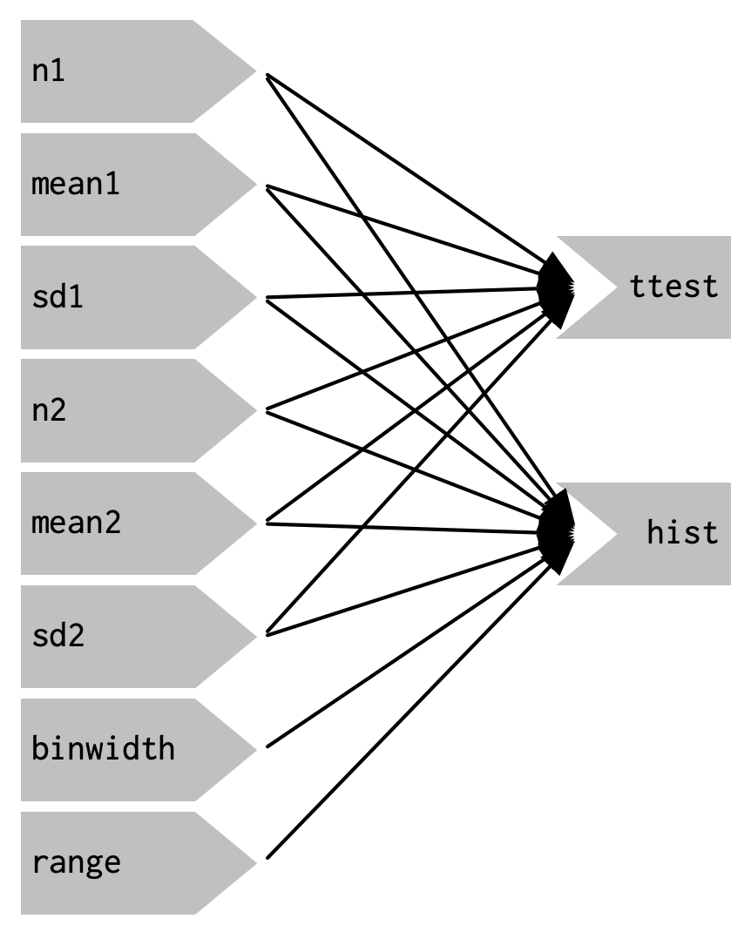
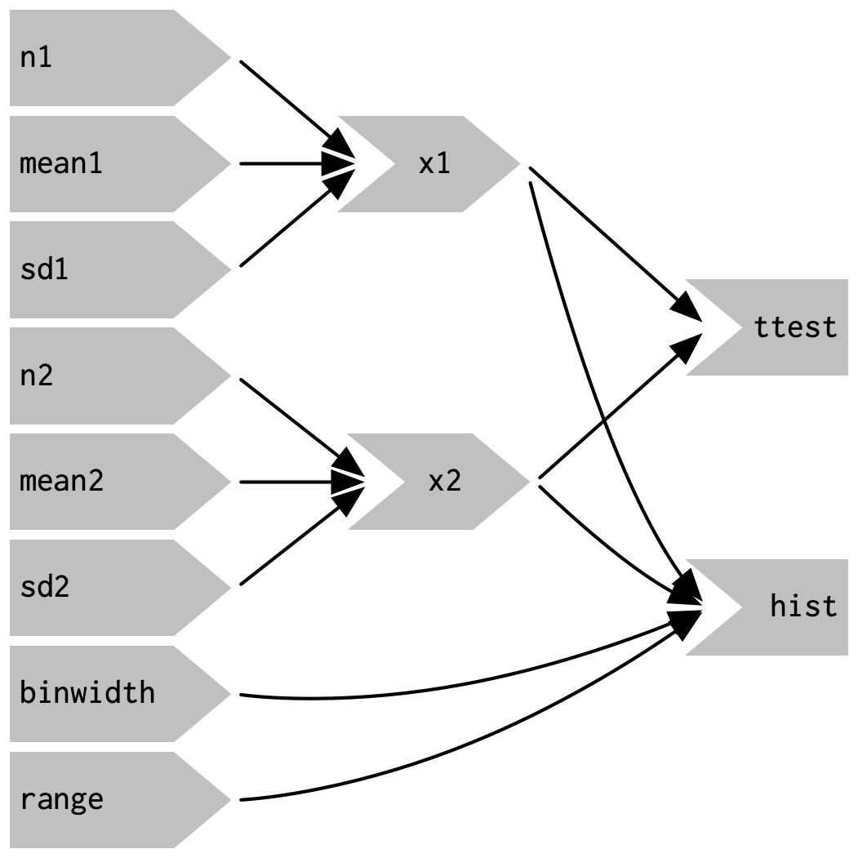
From mastering-shiny.org )chapter 4(
(and in the reactivity context chapters 13-16 are also recommended)

Slide 8
Intermediate, Not So Shiny #3: Not thinking like a software engineer
As you grow, your projects get more complex, someone is paying you for them, you have more users, and you need to maintain a proper service level
You need to start thinking like a software engineer (and not just as the data scientist you are)
For example here are some “non-data science” questions:
Are you using a Dev -> Test -> Stage -> Production cycle?
Are you working in agile or waterfall?
Are you automating your tests? (unit testing)
Are you planning your resources and budget? (e.g., for AWS/Azure/gcp)
The list goes on and on….

Slide 9
Intermediate, Not So Shiny #4: Not splitting your code to modules
Ever think about a world without functions? I couldn’t either.
When your app gets complex, you should use modules: splits recurring input-output into basic units (just like functions split recurring actions)
Original app:
The module (behind the scenes)
Very long UI
App using module:
One liner UI function
Very long server
One liner server function
code/modules/app.R

Slide 10
Advanced, Not So Shiny #5: Not sharing what you learned
At an advance level, be sure to spread the 💕 and help others
(Actually this is true in general, not just shiny)
Blog about stuff
Present/show up for meetups
Answer stackoverflow questions
Develop open source packages
Discussions on FB…

Slide 11
Some related resources
This presentation and all the live-coding apps are available
https://github.com/adisarid/meetup_not_so_shiny
Learn from your mistakes – tidyverse (Hadley Wickham)
https://www.youtube.com/watch?v=vYwXMnC03I4
Mastering-shiny.org
A must read book. Currently in draft, set for release during 2020

Slide 12


Thanks! We’re hiring. Ask me about it.
Adi Sarid
adi@sarid-ins.co.il
@SaridResearch
https://www.sarid-ins.co.il
https://adisarid.github.io

